Slide 1
Youth Apprenticeship
NEW MENTOR TRAINING

Slide 2
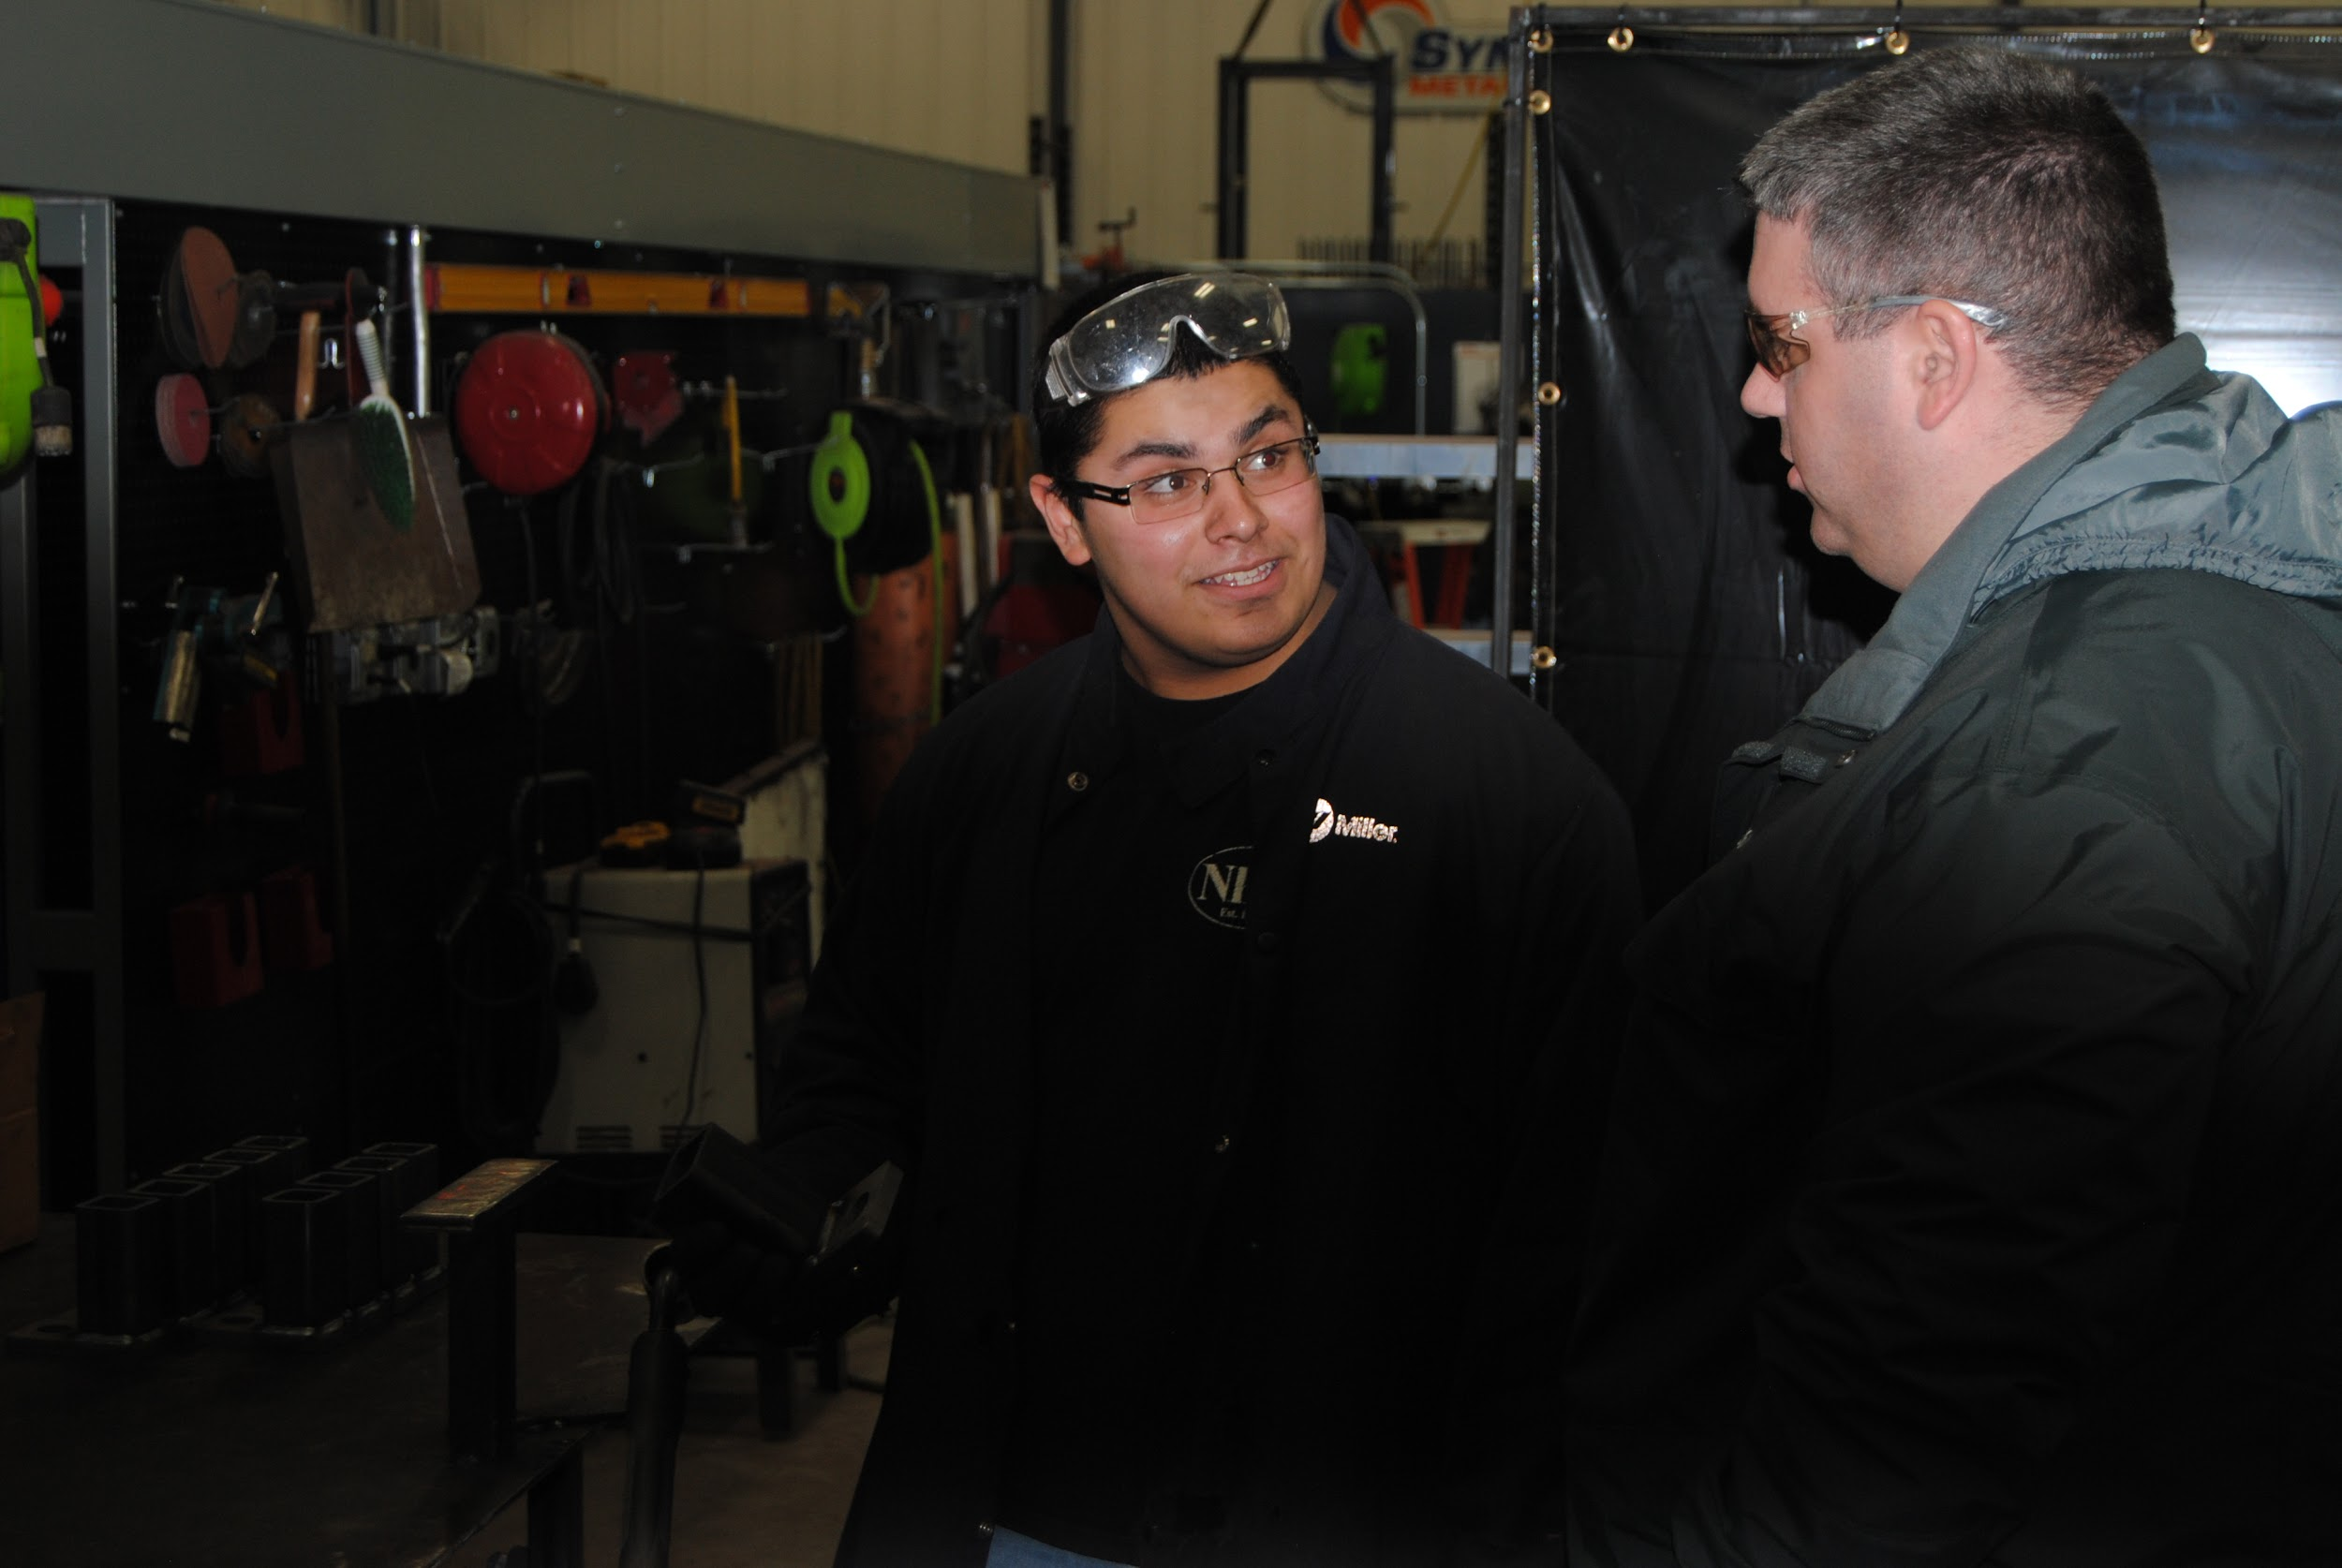
Welcome
Objectives:
Understand the Youth Apprenticeship Program
Understand the Roles and Responsibilities of:
School/District
Students
Employers/Mentors
Notes:
Story connecting the importance of mentors in young people’s lives and how both the student and employer benefit

Slide 3
What is Youth Apprenticeship
*Statewide School-to-Work initiative since 1991*
Program Timeframe:
Level One
Junior OR Senior year of High School
450 Hours of work based learning-MINIMUM
2 semesters of related classroom instruction
Level Two
Junior AND Senior year of High School
900 Hours of work based learning-Minimum
4 semesters of related classroom instruction
Notes:
Stress related instruction and that although they should be treated like other employees, these are still high school students
Highlight related instruction and hours requirement

Slide 4
YA’s 11 Career Clusters:
Agriculture, Food & Natural Resources (AFNR)
Architecture and Construction
Arts, A/V Technology & Communications
Finance
Health Sciences
Hospitality, Lodging and
Tourism (HLT)
Information Technology (IT)
Manufacturing
Marketing
Science, Technology, Engineering & Math (STEM)
Transportation, Distribution and Logistics (TDL)

Slide 5
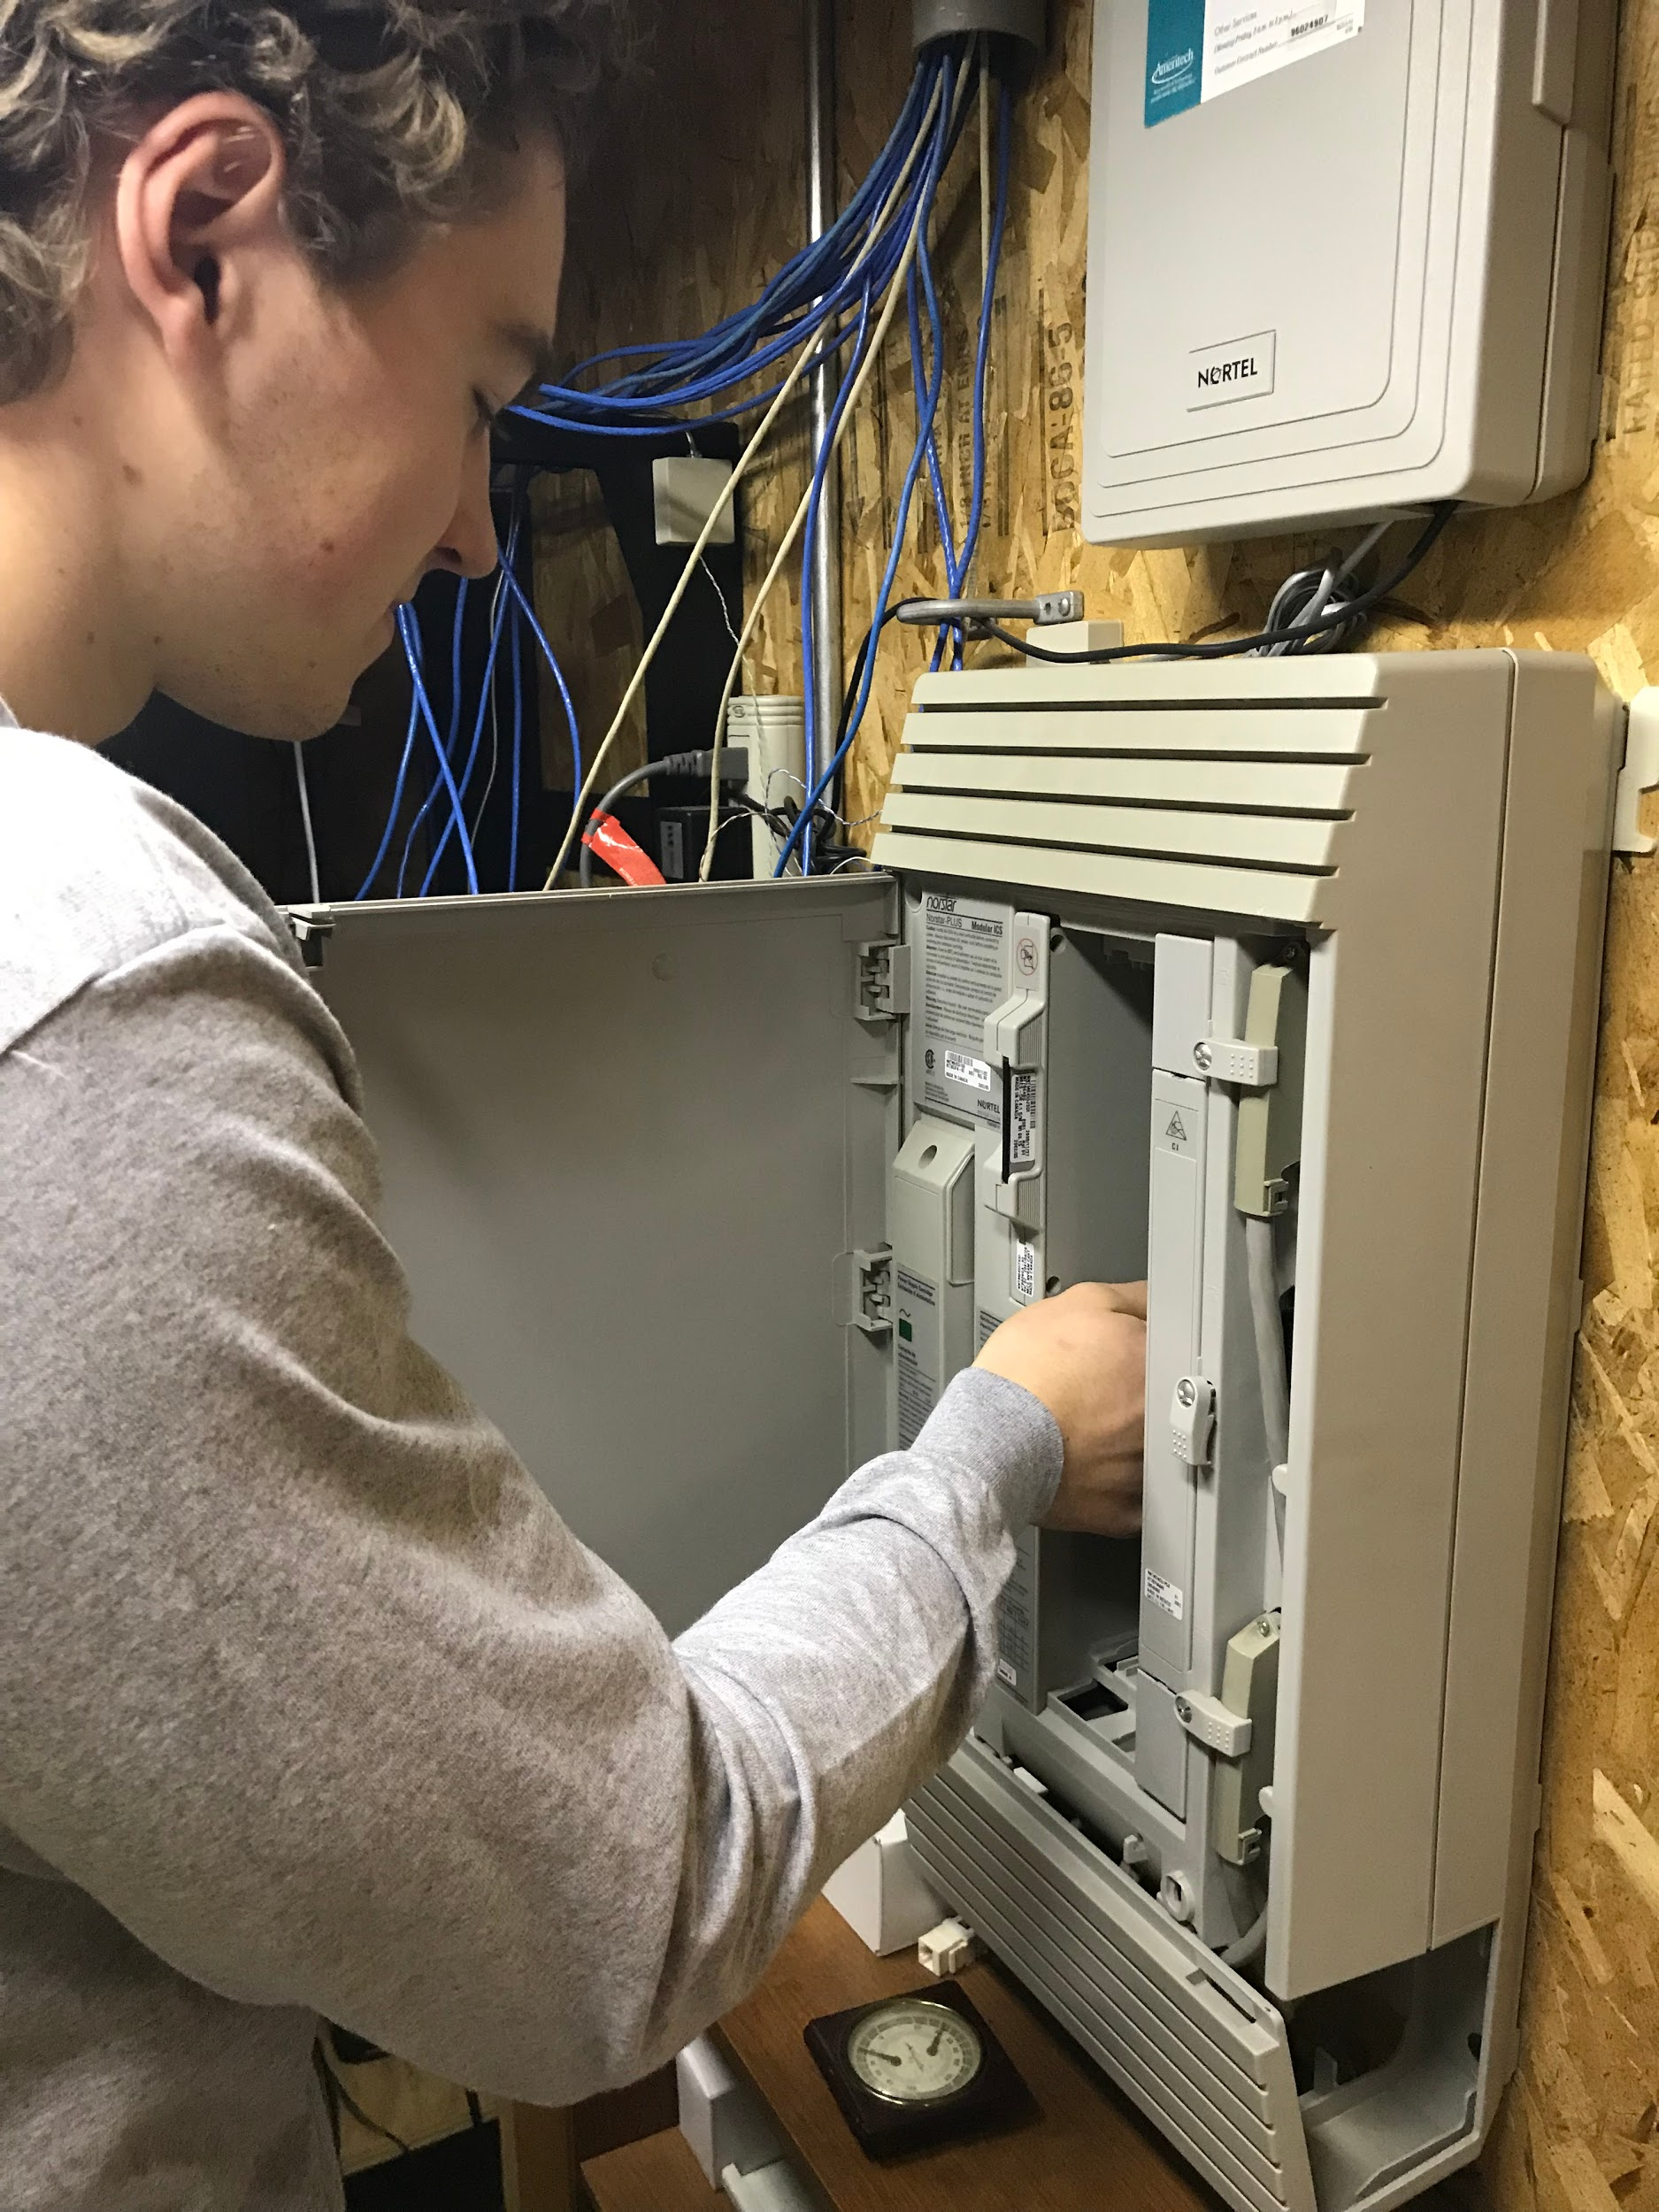
YA Program Design
Key Elements of the YA Program
Skilled Mentors assigned to train the students
Related classroom instruction
Exposure to multiple aspects of the industry
Performance evaluations
State-Issued skills certificate

Slide 6
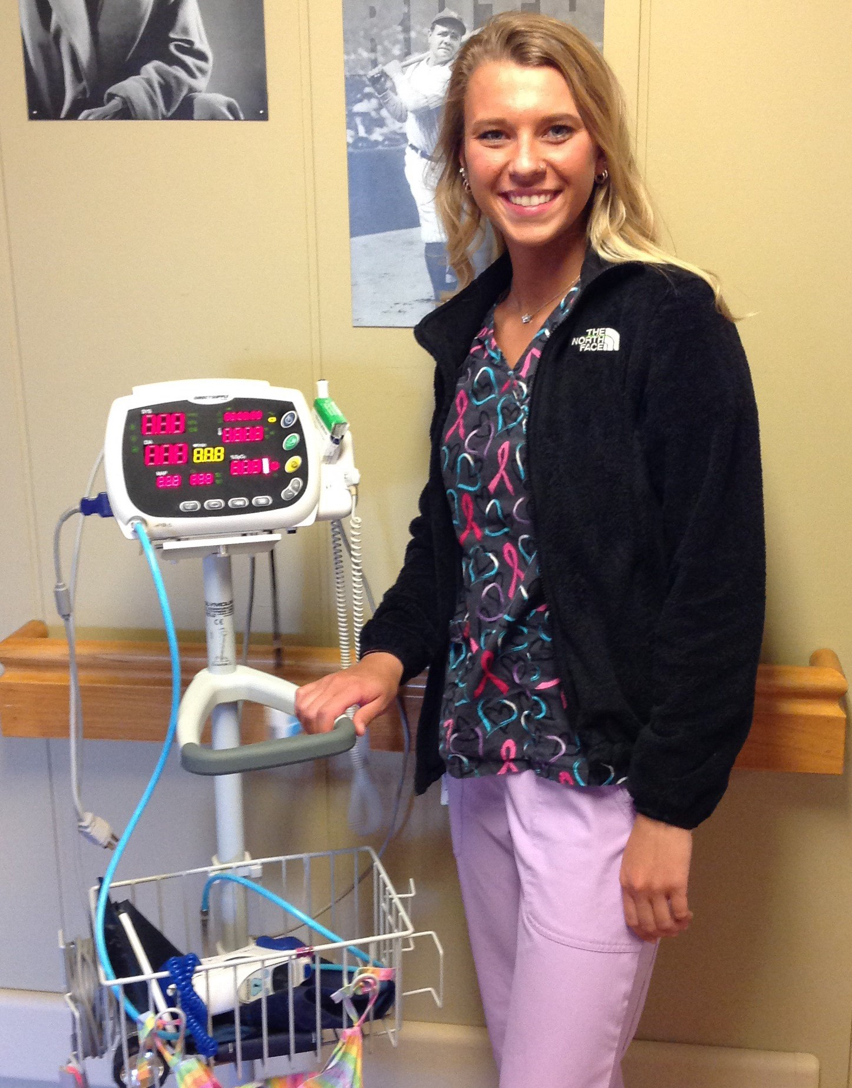
Related Instruction
Can be accessed through:
High school
Tech school (Start College Now)
Online courses
Student organizations (ie. OSHA 10)
24 hours of Continuing Education for 2nd year electricians

Slide 7
School District Responsibilities
Make sure student meets High School graduation requirements
Provide opportunity to complete all requirements of the YA program
Participate in quarterly student check ins
Award credit towards graduation

Slide 8
Working With The School District
Make sure you know who your contact is
Consider introducing yourself to the apprentices’ teachers / counselors / parents
Communicate any problems early - Apprentices should be treated like other employees, but some issues may be able to be coached through, like timeliness if the district knows there is an issue
Make sure that student/employer have the same work expectations (snow days, non-school days)

Slide 9
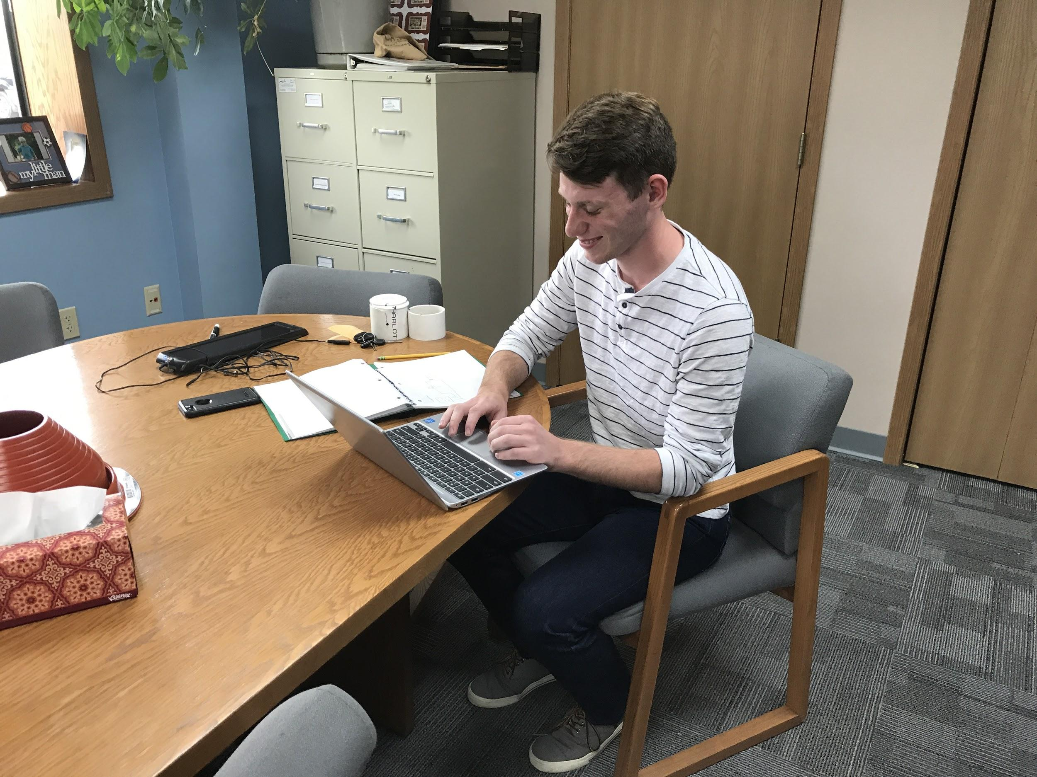
Student Roles & Responsibilities
Maintain attendance & good academic standing
Observe company rules and requirements
Participate in regular process reviews
Exhibit maturity and growth in workplace setting

Slide 10
Employer Responsibilities
Interview and hire a high school student as a youth apprentice
Evaluate Apprentice quarterly on Skills Standards and Employability Checklists
Provide safety instruction & comply with child labor laws
Pay your apprentice minimum wage or more, as agreed upon with the apprentice
Appoint a skilled mentor to provide active training/coaching
Maintain relevant communication with the School District

Slide 11
Employer Responsibilities
Some best practices might include:
Reviewing the YA’s resume with mentor/supervisor
Provide an offer letter to the YA
Clarify start date, work hours, etc with mentor and YA
Review company policies with YA

Slide 12
Student Learner Labor Laws
The Student Learner Exemption applies to the YA program: A "student learner" is a student of an accredited school who is employed on a part–time basis to obtain both scholastic credit and employment training under a bona fide written school-work training program agreement.
A student learner is permitted to do some work that is otherwise prohibited if the student learner is performing service within a youth apprenticeship program.

Slide 13
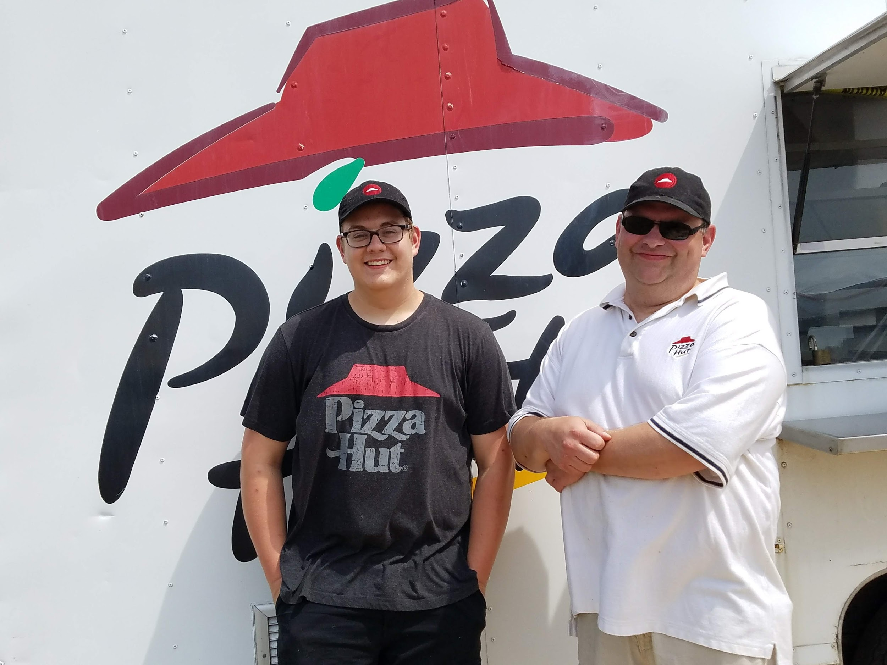
Employer Benefits
Help build qualified future workforce
Train your own future “star employees”
Provide structured managerial experience for staff
Enhance your organization’s community involvement

Slide 14
Mentor Responsibilities-Daily/Weekly
Introduce the apprentice into the business’s culture
Communicate the importance of quality work and company expectations
Facilitate student growth through skill development and career awareness
Verify hours by signing weekly reports, notify student of who can sign reports in your absence
Provide support, encouragement and direction

Slide 15
Mentor Responsibilities-Intermittently
Review student progress with student every 9-12 weeks (included in student binder)
Evaluate work site progress and communicate to student, parents, and school personnel quarterly through Student Performance Evaluations

Slide 16
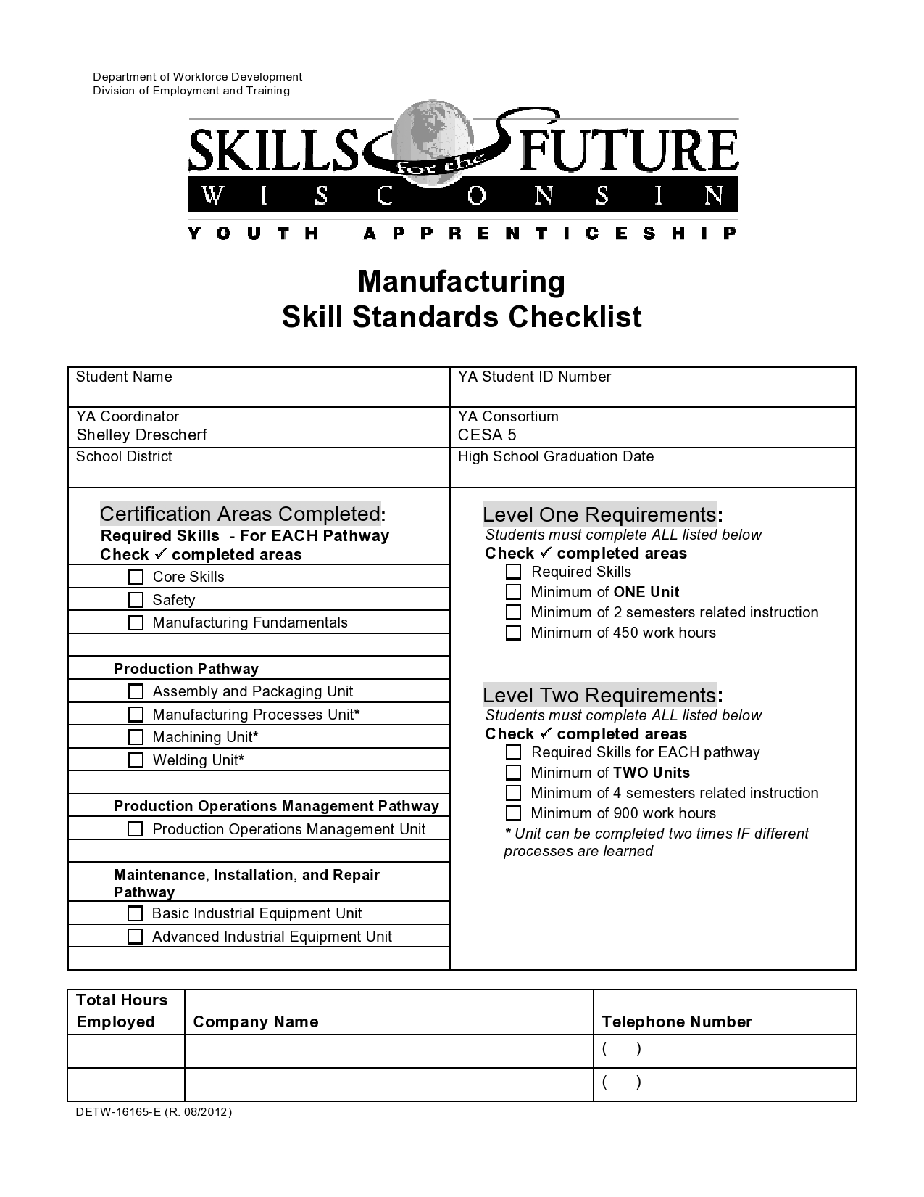
Skill Standards Checklists
* A packet of required documents will be provided to the employer and managed by the YA
To be completed by Mentor
Used to gauge Youth Apprentice’s competence
All program areas have core skills (basic employability skills) and safety.
Pathway skills are specific to a career field

Slide 17
Communication
Key to a successful Youth Apprenticeship program
Seek help from school contacts if a student’s personal problems interfere with work or school
Provide any relevant counseling on work-related matters
Provide support, encouragement and direction

Slide 18
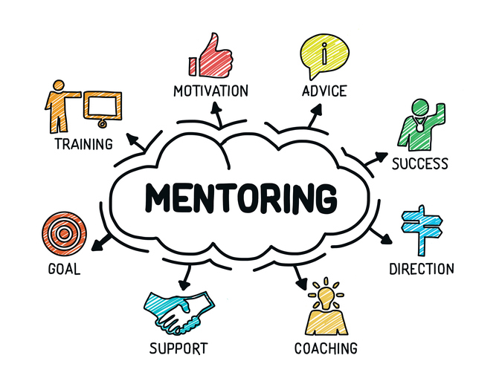
Traits of an Effective Mentor
Open communications skills
Technical competence
Interest in training young people
Willing to share knowledge
Positive attitude

Slide 19
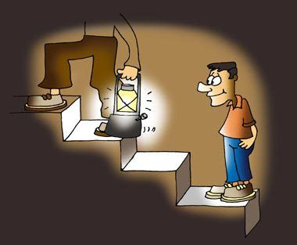
Mentoring Best Practices
Demonstrate skill to be learned
Point out key items and check for understanding
Allow student to master skill under supervision
Encourage apprentice to ask questions
Help apprentice become part of the team

Slide 20
YA Workplace Orientation
Tour/Introductions
Logistics: Check-in/out time and procedures, breaktime and appropriate workplace clothing
Train student on proper workplace safety procedures
Inform student of company policies regarding: sexual harassment, safety and technology use(cell phones, Facebook, Twitter, Internet surfing etc)
Discuss method of communication-text, email, phone call

Slide 21
What Students Want Employers to Know
I need concrete timelines
I need to know my boundaries
Help me understand the consequences
Give me the big picture and how I fit in
This is my FIRST job
I want to please
Believe in me
My self-esteem is pretty shaky
I am not an adult
I am still in high school
Let me finish one task before I start another

Slide 22
Youth Apprenticeship Contacts
Shelley Drescher
DrescherS@cesa5.org
Phone: (608) 745-5482
Joel Evenson
EvensonJ@cesa5.org
Phone: (608) 745-5483
This project was made possible with support from the Wisconsin Youth Apprenticeship Grant.

